Slide 1
Why Does My Computer Do That? Intro to Coding with Python– Code Reuse
Dr. Ab Mosca (they/them)
Slides based off slides courtesy of Jordan Crouser (https://jcrouser.github.io/)

Slide 2
Reminder
Midterm on Friday!
You don’t have homework this week so that you have time to study

Slide 3
Plan for Today
Quick review of ”coding best practices”
Some ethical questions
Using online resources ethically
How to attribute someone else’s code

Slide 4
Discussion
We’ve talked a lot about ideas like:
“S⁴”: start small | slow | simple
Organizing your code so it’s easy to reuse pieces
Documenting your code so it’s easy to come back to it
Forking code from other people’s repositories
Can you think of ethical concerns for any of this?

Slide 5
The balancing act…
EFFICIENCY
(not re-implementing)
…so how do you know when it’s okay to reuse code?
INTEGRITY
(not cheating)

Slide 6
Let’s consider a more familiar case…
Same or different?
Notes:
plagiarism

Slide 7
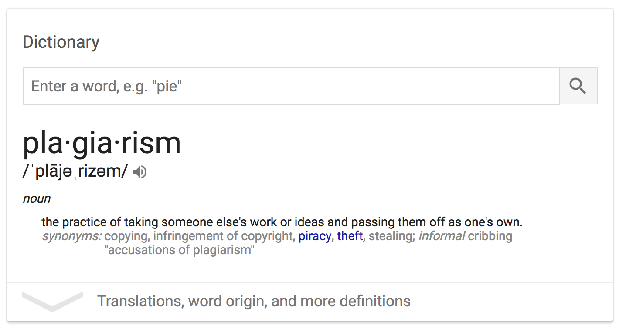

Slide 8
Scenario 0: self-reuse, not in a class
You wrote a program that solved a particular problem as part of a project you’re working on for fun
Later on for a different project you’re working on for fun, you need to solve the same problem
Questions:
Can you reuse the code?
Does it matter what the code does?
Do you need to attribute the code?

Slide 9
Scenario 1: self-reuse, in-class work
You wrote a program that solved a particular problem for a previous assignment in a course
Later on for a project you’re working on for fun, you need to solve the same problem
Questions:
Can you reuse the code?
Does it matter what the code does?
Do you need to attribute the code?

Slide 10
Scenario 2: self-reuse, same course
You wrote a program that solved a particular problem for a previous assignment in a course
In a later assignment for that same course, you need to solve the same problem as part of a larger process
Questions:
Can you reuse the code?
Does it matter what the code does?
Do you need to attribute the code?
Does it matter if you copy/paste or import it?

Slide 11
Scenario 3: self-reuse, different course
You wrote a program that solved a particular problem for a previous assignment in a course
In an assignment for a different course, you need to solve the same problem
Questions:
Can you reuse the code?
Does it matter what the code does?
Do you need to attribute the code?
Does it matter if it’s the whole assignment, or just one part?

Slide 12
Scenario 4: self-reuse, academic work →
You wrote a program that solved a particular problem for an assignment in a course
You later get a job as a software engineer, and you need to solve the same problem
Questions:
Can you reuse the code?
Does it matter what the code does?
Do you need to attribute the code?
Does it matter if it’s the whole assignment, or just one part?

Slide 13
Scenario 5: professors and TAs
You are trying to solve a particular problem for an assignment in a course, but you are stuck
You ask the professor or TA for advice, they walk you through how to implement one of the functions
Questions:
Can you use the code?
Does it matter what the code does?
Do you need to attribute the code?

Slide 14
Scenario 6: peers
You are trying to solve a particular problem for an assignment in a course, but you are stuck
You ask a friend who took the class last year, they walk you through how to implement one of the functions
Questions:
Can you use the code?
Does it matter what the code does?
Do you need to attribute the code?

Slide 15
Scenario 7: online sources
You are trying to solve a particular problem for an assignment in a course, but you are stuck
You look online to try to understand a concept, someone walks through how to implement one of the functions
Questions:
Can you use the code?
Does it matter what the code does?
Do you need to attribute the code?

Slide 16
Common online Q&A resources

Slide 17
How to attribute online code
# ------- START ATTRIBUTED CODE SECTION -------
# Code created with the help of Stack Overflow
# https://stackoverflow.com/questions/49581417
#
# Question by Alden:
# https://stackoverflow.com/users/9378177/alden
#
# Answer by CD Lane:
# https://stackoverflow.com/users/5771269/cdlane
# ...THE ACTUAL CODE GOES HERE...
# --------- END ATTRIBUTED CODE SECTION --------

Slide 18
Rules for code reuse
Always attribute
Only use code you actually understand
If it’s for a course, talk to the professor first
Understand the license, e.g. for StackOverflow

Slide 19
Activity: code reuse
With your group, pick a simple game
Use online resources to find a working python implementation
One partner: make a new repl containing the code you found, add your partners as collaborators
Write up the attribution
Make sure that you understand each piece of the code (add lots of comments!)
Be prepared to share with the class what your code does

Slide 20
Show and tell
What did you find?
How does it work?

